Slide 1


COMPUTER SCIENCE AND ENGINEERING
Placement Data for last Five Years

Slide 2
RECORD FOR LAST 5 CONSECUTIVE YEARS
YEAR | TOTAL STUDENTS | NO. OF STUDENTS PLACED | %PLACED
2018-2019 | 42 | 30 | 71.42
2019-2020 | 45 | 33 | 73.33
2020-2021 | 36 | 29 | 80.56
2021-2022 | 46 | 23 | 50
2022-2023 | 47 | 38 | 80.85

Slide 3
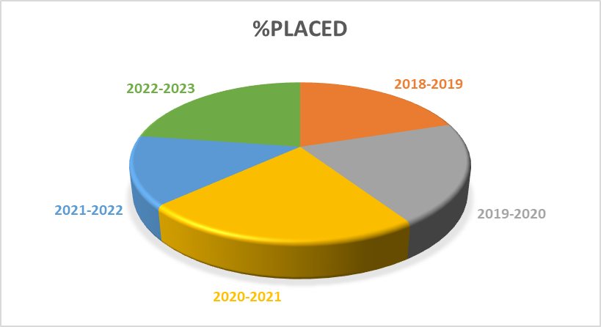
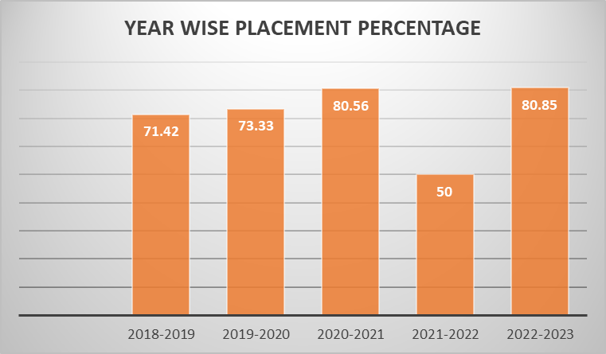

Slide 4
MAJOR RECRUITERS | MAJOR RECRUITERS | MAJOR RECRUITERS | MAJOR RECRUITERS
Amazon | Cognizant | Wipro | INFOSYS
Tata Consultancy Service | IBM | Capgemini | EPAM System
Nihilent Limited | Applied Reseach Works | CTS | GEOGO Techsolutions Pvt. Ltd.
American Express | Embibe | CloudKaptan | I&T
Kovair | Qualtech Consultants Pvt Ltd. | Hitach | Swardsman Infosol
Veda IIT | Novus Info Limited | ADP | Qualcomm
Expertrons Technology Pvt Ltd | TRL Krosaki Refractories Limited | TRL Krosaki Refractories Limited | Silver Touch Technologies Ltd
Innostes Solution PVT LTD | JABOTICS | CDAC Kolkata | Geogo Techsolution Pvt Ltd
Lumen Technology | LTIMindtree | West Bengal Police (WBP) | Navsoft, Topsia Kolkata

Slide 5
  TCS (TATA CONSULTANCY SERVICES): 43
  COGNIZANT: 31
  WIPRO: 16
  MINDTREE: 2
  INFOSYS: 33
  CLOUDKAPTAN: 3
  CAPGEMINI: 4
  NIHILENT LIMITED: 2
  APPLIED RESEARCH WORKS - COZEVA: 1
  IBM: 10
  EPAM SYSTEMS: 2
  KREETI TECHNOLOGIES: 2
  QUALTECH CONSULTANTS PVT. LTD.: 2
  NEEBAL TECHNOLOGY: 1
  GEOGO TECHSOLUTIONS PVT. LTD.: 1
  HITACHI VANTARA: 3
  NUCLEUSTEQ: 2
  EXPERTRONS TECHNOLOGY PVT LTD: 1
  SILVER TOUCH TECHNOLOGIES LTD.: 1
  NEST INNOVATIVE SOLUTIONS PRIVATE LIMITED: 1
  AMAZON INDIA: 1
  INNOSTES SOLUTION PVT LTD: 1
  AMERICAN EXPRESS: 2
  EMBIBE (INDIAVIDUAL LEARNING LIMITED): 1
  ALLIED MEDIA INC.: 1
  TATA CONSULTANCY SERVICES PVT LTD: 20
  CID, WEST BENGAL: 1
  WEST BENGAL POLICE (WBP): 1
  NAVSOFT, TOPSIA KOLKATA: 2
  PRICE WATERHOUSE COOPERS PWC: 1
  CDAC KOLKATA (UNDER MANPOWER GROUP): 1
  GEOGO TECHSOLUTION PVT LTD: 1
  LUMEN TECHNOLOGY: 1
  CTS (COGNIZANT TECHNOLOGY SOLUTIONS): 2
  HURON EURASIA INDIA PRIVATE LIMITED: 2
  KREETI TECHNOLOGIES PVT LTD: 1
  QUALCOMM: 2
  LTIMINDTREE: 1
  CLOUDKAPTAN: 1
  LOUNGE (UK): 1
  JABOTICS : 1

Slide 6
8 lpa
6 lpa
4 lpa
2 lpa
0 lpa
Highest Salary :
Lowest Salary :
Average Salary:

Slide 7
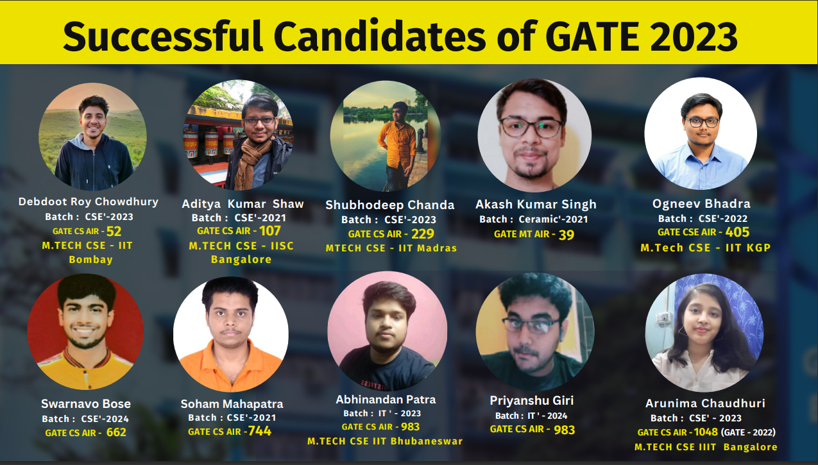

Slide 8
THANK YOU

